Slide 1
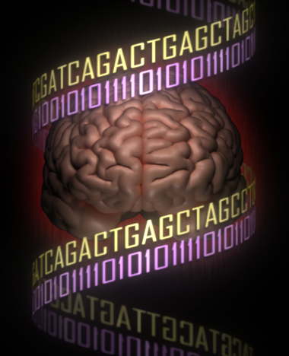
A brief history of imaging genetics
Jason Stein
Assistant Professor
Department of Genetics & Neuroscience Center
UNC-Chapel Hill
Introduction to Imaging Genetics, 2018

Slide 2
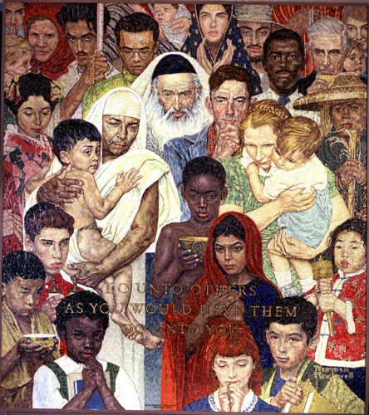
Human genetics
99.9% of DNA identical between any two people
DNA variation causes changes in height, personality, predisposition to disease, and brain structure.

Slide 3
Outline
Types of genetic variation in the human genome
Some big questions in imaging genetics
Heritability
Imaging genetics history
Progress in answering the big questions

Slide 4
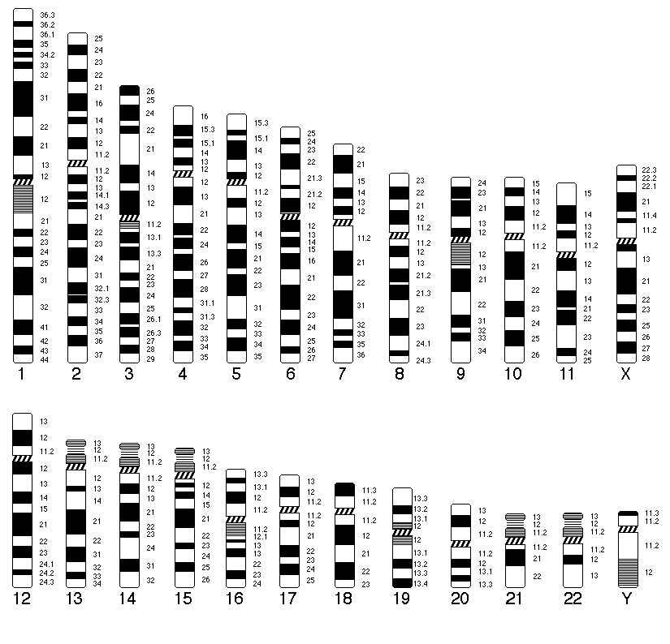
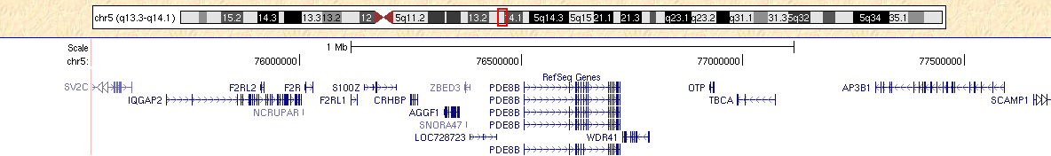
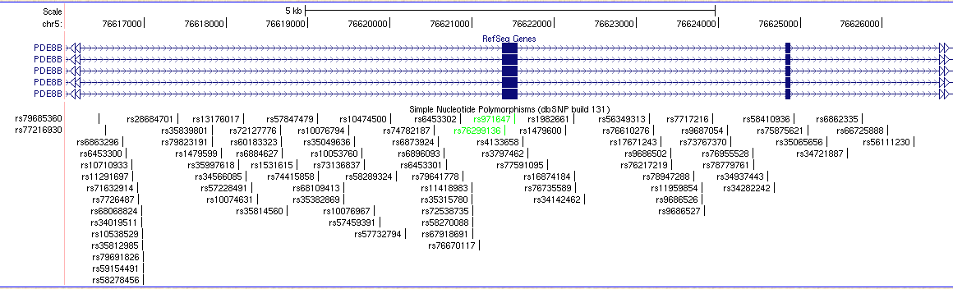
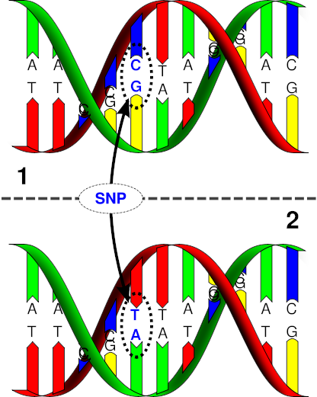
Human genetics: terminology
UCSC genome browser
http://genome.ucsc.edu/
23 pairs of chromosomes
In a particular part of the chromosome 5 there are many genes
Within a gene there are exons,
introns, and SNPs
Single Nucleotide Polymorphism (SNP)

Slide 5
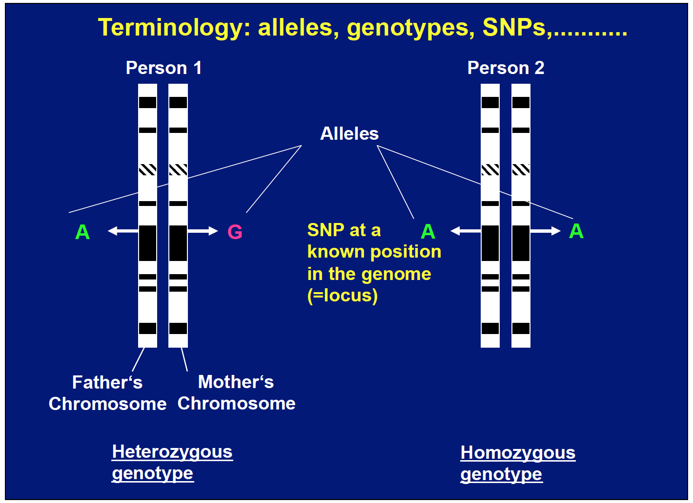
Human genetics: terminology
If allele G is associated with risk for disease, it is the risk allele.
That makes allele A the protective allele.
Slide courtesy of Sven Cichon

Slide 6
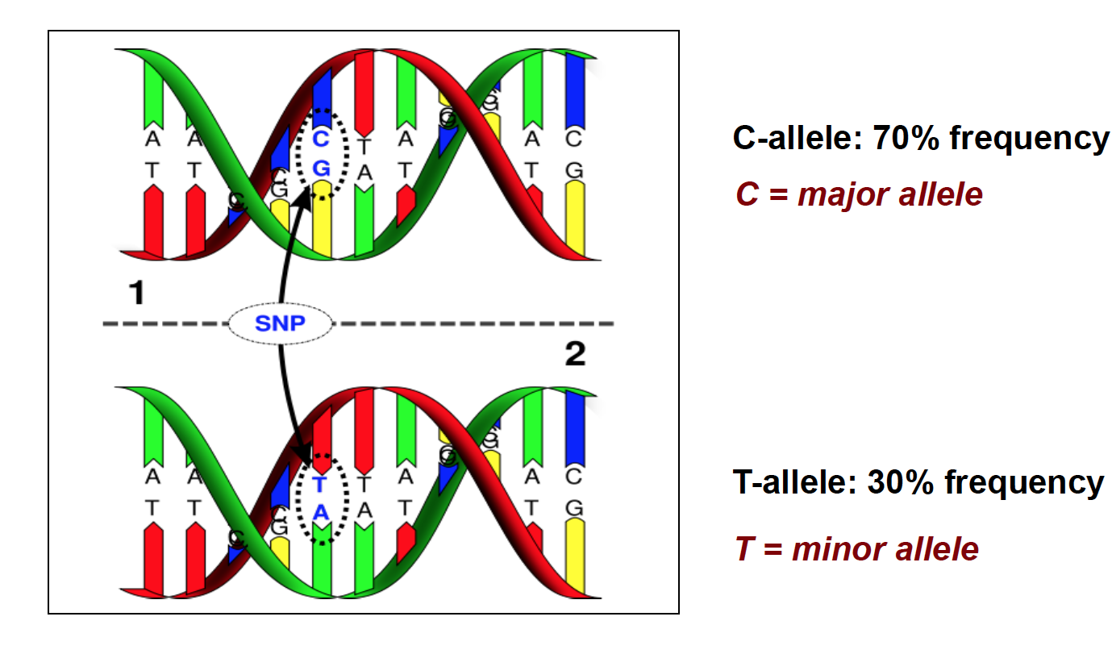
Human genetics: terminology
Slide courtesy of Sven Cichon

Slide 7
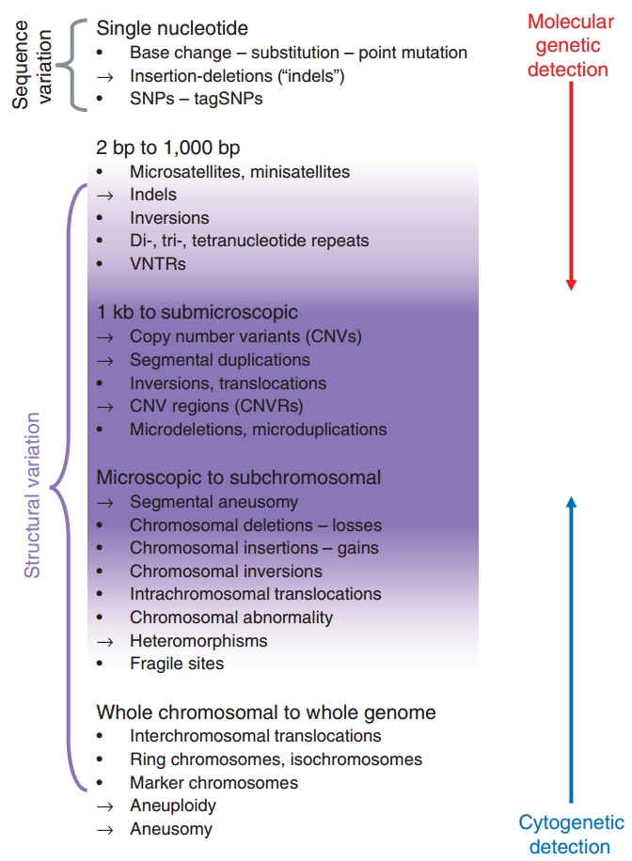
Genetic variation across size spectrum
(Scherer, Nature Genetics, 2007)
Notes:
Structural variant. Structural variant is the umbrella term to encompass a group of genomic alterations involving segments of DNA typically
larger than 1 kb, and which can be microscopic or submicroscopic1. We use the term as a neutral descriptor with nothing implied about
frequency, association with disease or phenotype, or lack thereof. This definition of size, though perhaps somewhat arbitrary, was undertaken to
accommodate this significant class of variation that spans the gap between small variants (such as variable number of tandem repeats (VNTRs))
detected with molecular genetic assays and those recognized microscopically on karyotypes. The structural variation may be quantitative (copy
number variants comprising deletions, insertions and duplications) and/or positional (translocations) or orientational (inversions).
Copy number variation/variant (CNV). We use these terms to refer to a DNA segment of at least 1 kb in size, for which copy number
differences have been observed in the comparison of two or more genomes. Without further annotation, CNV carries no implication of relative
frequency or phenotypic effect. These quantitative variants can be genomic copy number gains (insertions or duplications) or losses (deletions
or null genotypes) relative to a designated reference genome sequence. A copy number polymorphism (CNP) is a CNV that occurs in more than
1% of the population.
CNV locus or CNV region (CNVR). Merging of independently ascertained, but overlapping, genomic segments creates the representation of
a CNV locus (that is, a segment at a fixed chromosomal position); the accumulation of data gradually will reveal the true underlying structure
of the variant segment. In some cases, this will be a discrete cassette of DNA; in others, it will be a multiplex arrangement of variant units in
close proximity, forming a CNV region11. A given variable segment can be detected with multiple clones in a single array or by different arrays
in different studies, and its borders gradually fine-tuned with targeted assays. By their very nature, these segments may have different forms
among the individuals used for their discovery.
Insertion/deletion (‘indel’). Indel is a collective abbreviation to describe relative gain or loss of a segment of one or more nucleotides in a
genomic sequence. It allows the designation of a difference between genomes in situations where the direction of sequence change cannot be
inferred: for example, when a reference or ancestral sequence has not been defined. It has typically been used to denote relatively small-scale
variants (particularly those smaller than 1 kb); however, we do not propose any size restriction for its use.
Segmental duplication (also called low-copy repeat (LCR) or duplicon). A segment of DNA >1 kb in size that occurs in two or more copies per
haploid genome, with the different copies sharing >90% sequence identity44,64,65. These segments can also be CNVs. The duplicated blocks
predispose to nonallelic homologous recombination.
Aneuploidy, aneusomy and heteromorphism. These terms have origins in classical cytogenetics and describe structural variants at the largest
end of the scale. Aneuploidy Aneuploidy is the state of having an abnormal number of chromosomes.
Aneusomy: In animals, the term generally refers to a diploid organism with subpopulations of aneuploid, somatic cells.
Heteromorphism: A chromosome pair with some homology but differing in size, shape, or staining properties. Homologous chromosome pair which are not morphologically identical (eg the sex chromosomes).

Slide 8
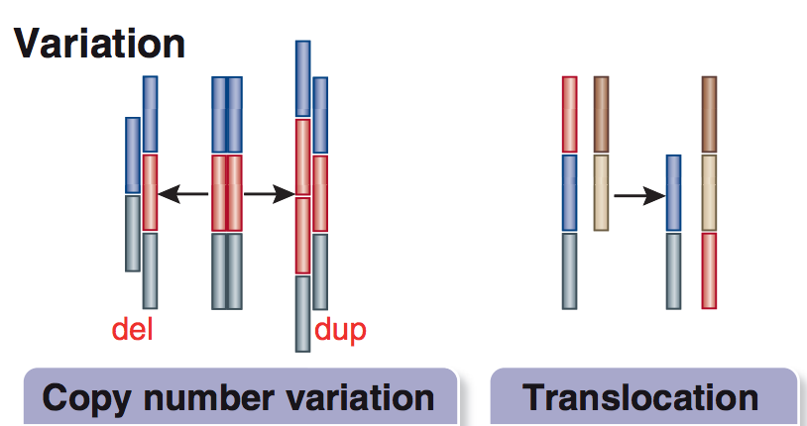
Copy number variations and translocations
The currently most commonly studied structural variants
(de la Torre, Nat Med, 2016)

Slide 9
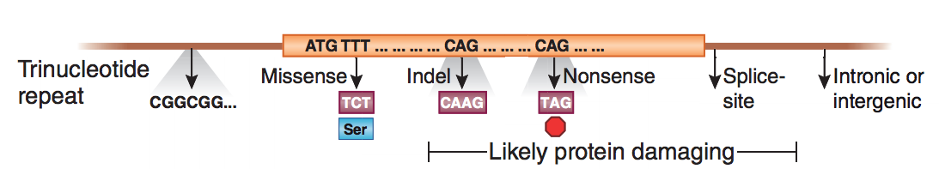
Exonic and intronic variation
~97% of the genome does not code for protein (either intergenic or intronic)
Mutations in protein coding regions often are easier to functionally interpret
(de la Torre, Nat Med, 2016)

Slide 10
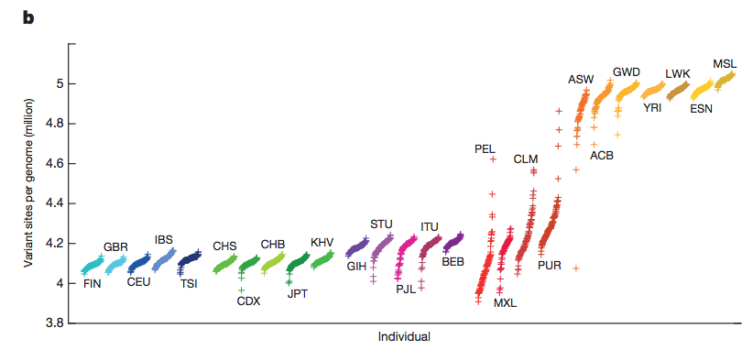
How many variants exist in each individual?
European
Asian
South American/Hispanic
African
Each individual has 4-5 million variants different from reference genome
>99.9% of those variants are SNPs or short indels
(1000 Genomes Project Consortium, Nature, 2015)
Notes:
Three things explain the differences in variants:
Reference genome is european
Out of africa created a bottleneck, so less variation in populations outside
Admixture (breeding between populations) induces genetic variation

Slide 11
Frequency of variants
Most detected variants in a population are rare
  ~64 million have frequency < 0.5%
  ~12 million have frequency between 0.5 and 5%
  ~8 million have frequency >5%
Most variants within an individual are common
  1-4% of variants have frequency < 0.5%
  ~96% of variants have frequency > 0.5%
(1000 Genomes Project Consortium, Nature, 2015)

Slide 12
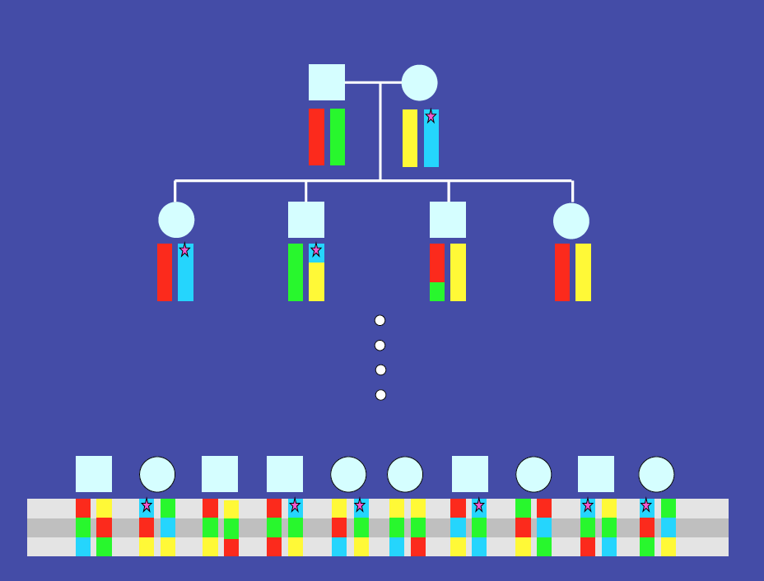
Linkage disequilibrium
During meiosis, crossing over between homologous chromosomes and recombination occurs.
This mixes your chromosome segments between mom and dad before passing them along.
This has the effect that genetic variants are inherited in chunks, so there is correlation between alleles at nearby SNPs.
Slide courtesy of Sven Cichon
Notes:
Male = square
Female = circle

Slide 13
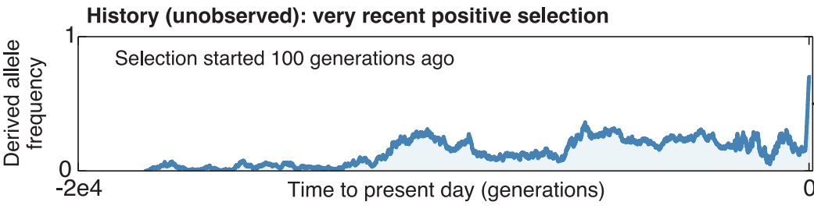
The history of mutations
Mutations happen in the population as a de novo (new mutation) and are necessarily rare.
They can undergo positive selection (increasing allele frequency) or purifying selection (decreasing allele frequency) based on their influence on survival or reproduction.
They can also undergo random genetic drift, randomly increasing or decreasing in frequency over long periods.
We generally do not know the evolutionary histories of each genetic variant in the human population.
(Field, Science, 2016)

Slide 14
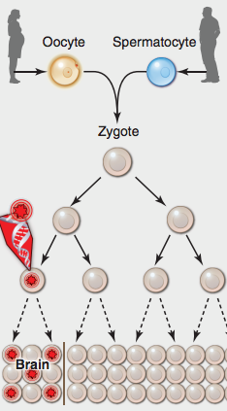
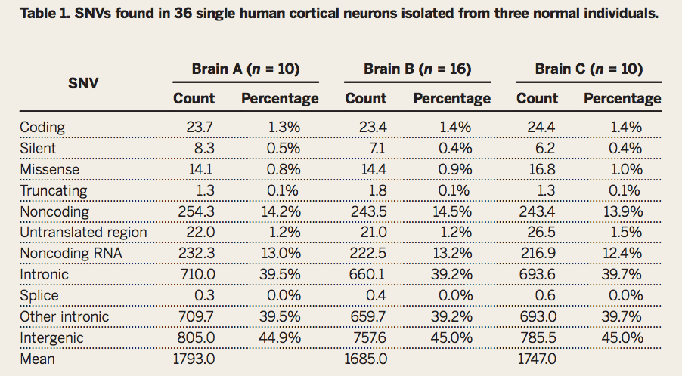
Somatic vs Germline Mutations
We previously assumed the genome sequence is identical between every two cells in the body, which is roughly true.
But, each neuron has ~1400 somatic mutations from single cell genome sequencing.
Brain-affecting somatic mutations will not be passed on unless they happen before development of gonads.
(Poduri, Science, 2013, Lodato, Science, 2015)

Slide 15
Relevance of genetic variation to brain structure
Many genetic variants exist in everyone’s genome.
Most likely have infinitesimally small effect on any trait
Which affect brain structure and function?

Slide 16
Outline
Types of genetic variation in the human genome
Some big questions in imaging genetics
Heritability
Imaging genetics history
Progress in answering the big questions

Slide 17
Some big questions in imaging genetics
How does genetic variation lead to disorders of the brain?
What cell-types and developmental processes impact brain structure?
Do genetic changes that affect brain structure also affect brain function?
What genetic changes have led to humans having big brains and unique cognitive capabilities?

Slide 18
Outline
Types of genetic variation in the human genome
Some big questions in imaging genetics
Heritability
Imaging genetics history
Progress in answering the big questions

Slide 19
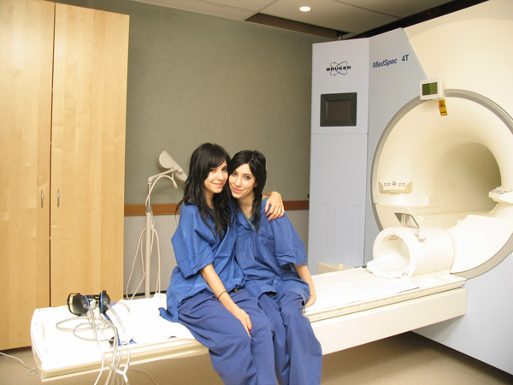
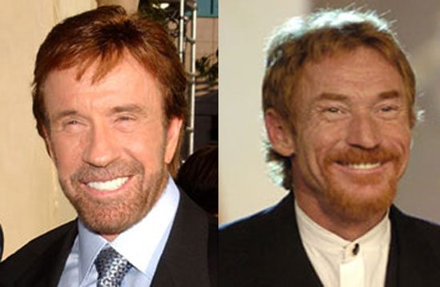
Twins and heritability
H² = σ²_{genetics} / σ²_{phenotype}
What percentage of trait/phenotype variance is due to genetic variation?
Identical twins
Share 100% of alleles + common environment
Fraternal Twins
Share 50% of alleles on average + common environment
Falconer’s heritability: h² = 2(r_{mz} – r_{dz})
Notes:
Monozygotic (identical – MZ) twins raised in a family share both 100% of their genes, and all of the shared environment. Any differences arising between them in these circumstances are random (unique). The correlation between identical twins provides an estimate of A + C. Dizygotic (DZ) twins also share C, but share on average 50% of their genes: so the correlation between fraternal twins is a direct estimate of ½A+C. If r is correlation, then rmz and rdz are simply the correlations of the trait in identical and fraternal twins respectively. For any particular trait, then:
rmz = A + C
rdz = ½A + C
A, therefore, is twice the difference between identical and fraternal twin correlations : the additive genetic effect (Falconer's formula). C is simply the MZ correlation minus this estimate of A. The random (unique) factor E is 1 − rmz: i.e., MZ twins differ due to unique environments only. (Jinks & Fulker, 1970; Plomin, DeFries, McClearn, & McGuffin, 2001).
Stated again, the difference between these two sums, then, allows us to solve for A, C, and E. As the difference between the identical and fraternal correlations is due entirely to a halving of the genetic similarity, the additive genetic effect 'A' is simply twice the difference between the identical and fraternal correlations:
A = 2 (rmz − rdz)
As the identical correlation reflects the full effect of A and C, E can be estimated by subtracting this correlation from 1
E = 1 − rmz
Finally, C can be derived:
C = rmz − A

Slide 20
Common misconceptions about heritability
High heritability implies genetic determination
  High heritability means that in the current population given its current environment, genetic variation explains a large amount of phenotypic variation. If the environment changes or is manipulated, the phenotype may change even with a highly heritable trait.
  Height is highly heritable but improved nutrition is associated with increased height.
Large heritability implies genetic variants of large effect
  High heritability means there are genetic variants influencing a trait. It does not tell you if there are many genetic variants influencing a trait or only one. It does not tell you if those genetic variants influencing a trait have a strong or weak effect.
(Visscher, Nat Rev Genet, 2008)

Slide 21
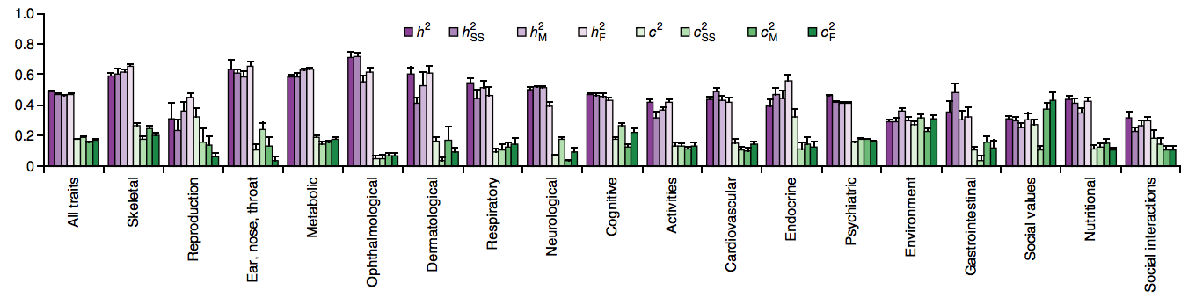
Most well-measured traits are heritable
A meta-analysis of 14,558,903 partly dependent twin pairs!
(Polderman, Nat Genet, 2015)
Notes:
h2SS = heritability same sex
h2M = male heritability
h2F = female heritability

Slide 22
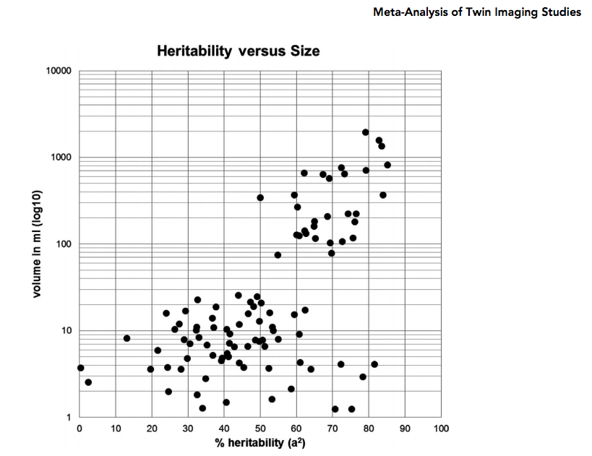
Heritability of human brain structure
Most well-measured (larger) brain structure traits are heritable
(Blockland, Twin Research and Human Genetics, 2012)

Slide 23
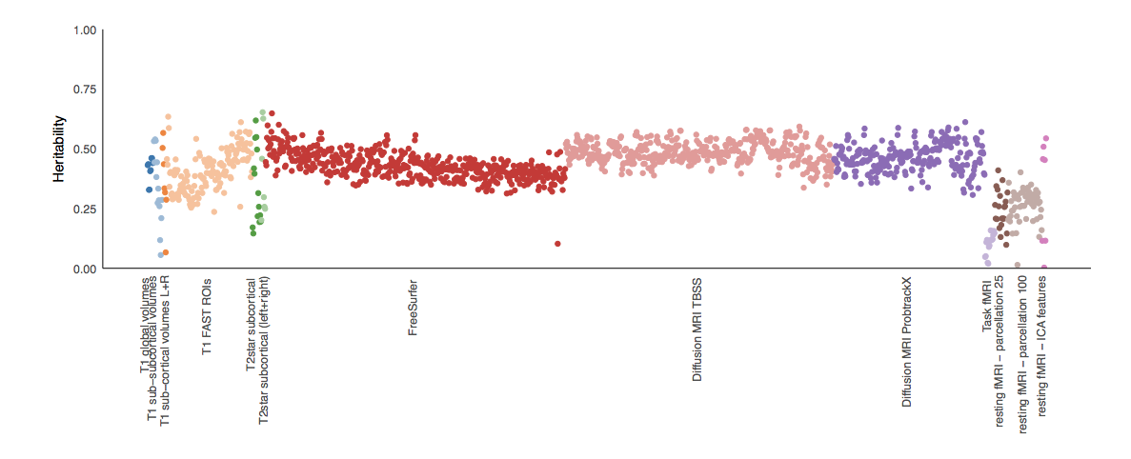
Heritability of human brain function
Structure
Function
Brain function measures based on fMRI have particularly low heritability
(Elliott, bioRxiv, 2017)
Notes:
Genetic variation clearly impacts brain structure, now to find it!

Slide 24
Outline
Types of genetic variation in the human genome
Some big questions in imaging genetics
Heritability
Imaging genetics history
Progress in answering the big questions

Slide 25
Assumptions of early imaging genetic studies
Measures of brain structure and function are “closer to the action of the gene” than behaviorally defined neuropsychiatric diseases
Measures of brain structure and function are genetically correlated to neuropsychiatric diseases
So,
  we need smaller sample sizes to detect genetic influences on brain than behavior
  genetic influences on brain will be informative about genetic influences on behavior
(Glahn, Hum Brain Mapping, 2007)

Slide 26
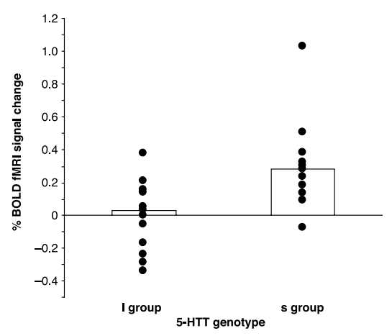
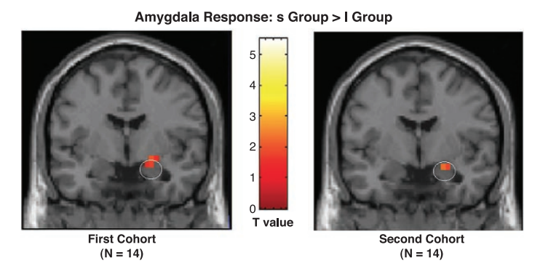
Crisis of reproducibility in imaging genetics
Effect size of a common variant here is > 40%
Sample size is small
Gene and variant chosen based on prior biological knowledge
(Hariri, Science, 2002)

Slide 27
Solving the crisis of reproducibility
“The literature of imaging genetic studies contains many false positives.”
Acknowledgement that we are bad at guessing the particular genes or variants involved in any biological process
Uniform significance thresholds established
  For common variant associations (GWAS) P<5e-8
Replication and meta-analysis required
Now associations replicate
(Sullivan, Biological Psychiatry, 2018;
Pe’er, Genet Epidemiology, 2008; Dudbridge & Gusnanto, Genet Epidemiology, 2008; McCarthy, Nat Rev Genet, 2008; Flint & Munafo, Curr Opin Neurobiology, 2013)

Slide 28
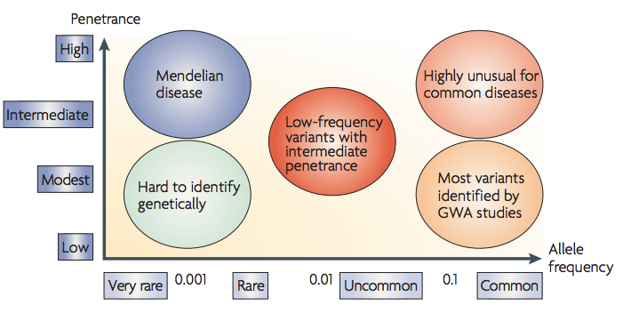
Different genotyping methods for different types of variants
Linkage
Genome/exome sequencing;
CNV calling
Genome-wide association
(McCarthy, Nat Review Genet, 2008)

Slide 29
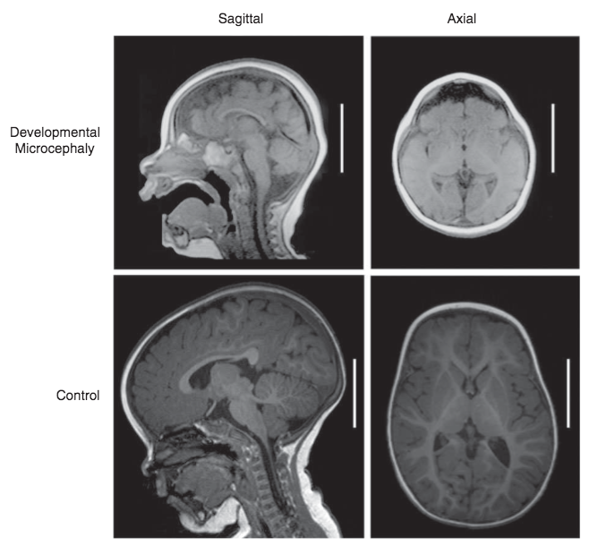
Rare variants associated with human brain structure alterations
Rare recessive variants, predominately affecting centrosomal proteins, can lead to primary microcephaly
(Gilmore & Walsh, Dev Biol, 2012)

Slide 30
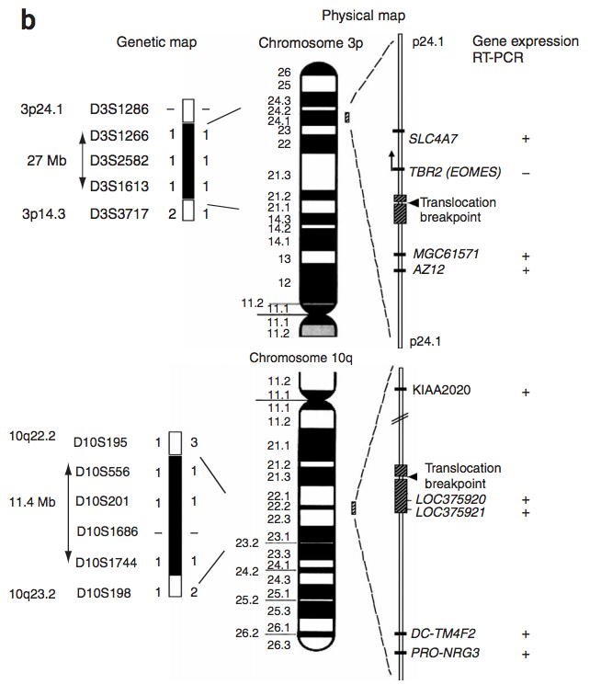
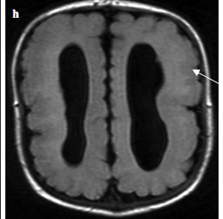
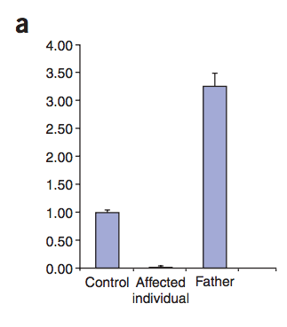
Balanced chromosomal translocation leading to microcephaly
Patients exhibit microcephaly, polymicrogyria, agenesis of corpus callosum
EOMES levels are absent in affected patients. The chromosome that contains the affected allele has no expression of EOMES.
The translocation was homozygous in each of the four affected individuals studied (46,XY,t(3;10)(p24;q23)2x), whereas healthy parents were heterozygous.
(Baala, Nat Genet, 2007)

Slide 31
Different genotyping methods for different types of variants
Linkage
Genome/exome sequencing;
CNV calling
Genome-wide association
(McCarthy, Nat Review Genet, 2008)

Slide 32
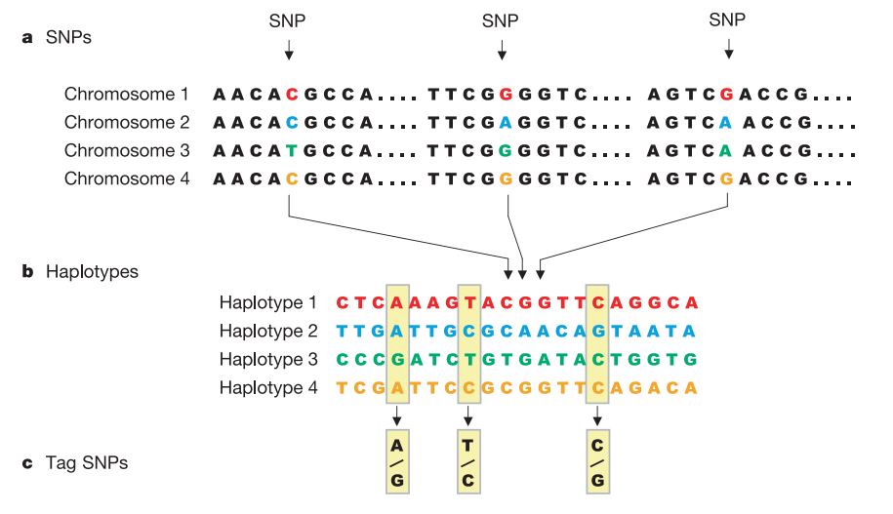
Tag SNPs
Because nearby SNP genotypes are correlated, we only need to genotype a subset of all SNPs in existence to, by proxy, measure most SNPs
Rare variants genotypes are less correlated with common variants, so this technique only works well for common variants
(International HapMap Consortium, Nature, 2003)

Slide 33
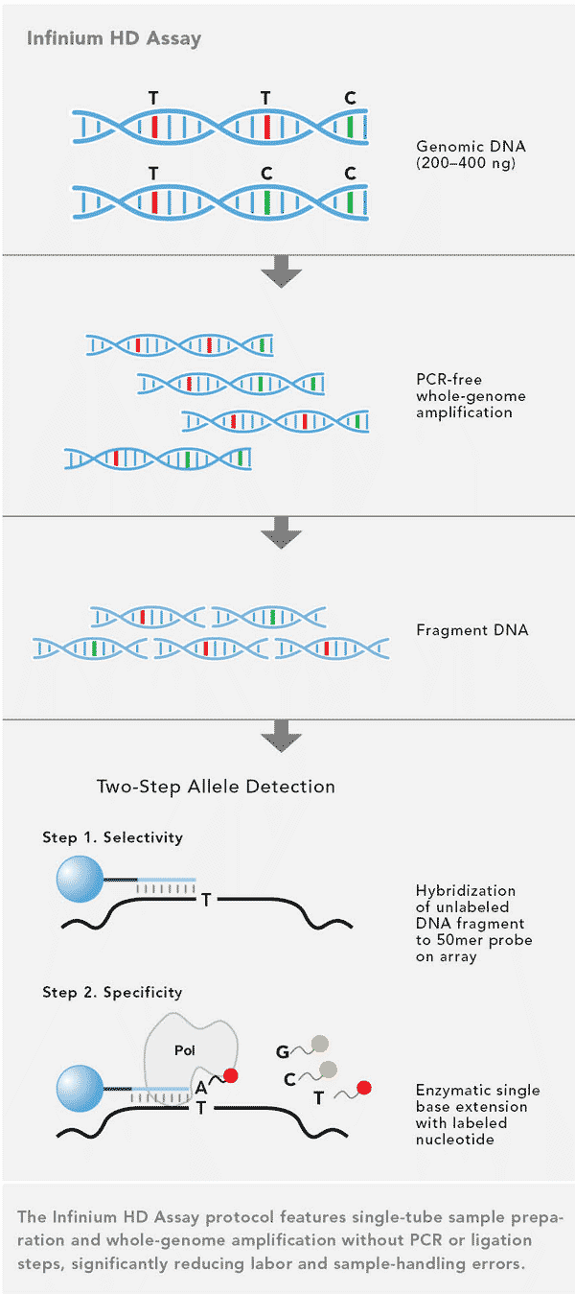
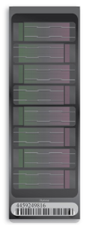
Genome-wide association studies: Genotyping
Arrays (~$100/sample) are cheap in comparison to genome sequencing (~$2000/sample), but only allow you to genotype common variants
(Illumina.com)

Slide 34
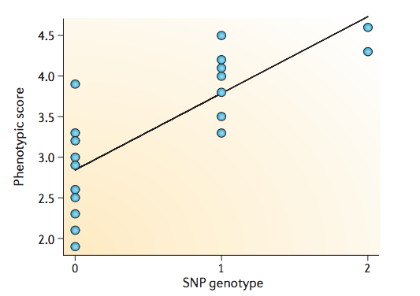
Genome-wide association studies: Association
Quantitative Phenotype
Slope of line of best fit indicates strength of the association.
A/A
A/G
G/G
Significance assessed through linear regression (probability that slope = 0)
For disease (binary) traits, use logistic regression vs linear regression – but same idea
Repeat for all genotyped (and imputed) SNPs
(Balding, Nature Reviews Genetics, 2006)

Slide 35
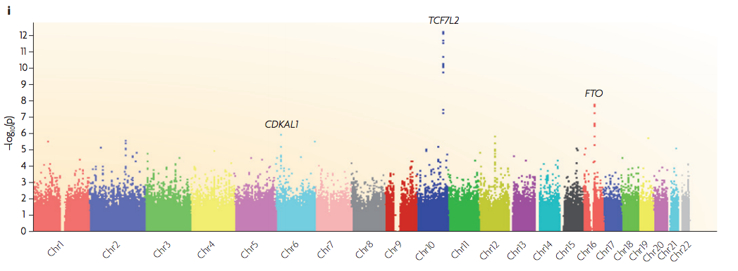
Genome-wide association studies: Manhattans
Manhattan plots show associations across the entire genome.
Each dot represents a SNP
Y-axis is significance calculated from association
X-axis is location along the genome
Because so many comparisons are conducted, must correct for multiple comparisons (by conducting more statistical tests you are more susceptible to false positive results).
Common genome-wide significant threshold is P<5x10⁻⁸
(McCarthy, Nat Review Genet, 2008)

Slide 36
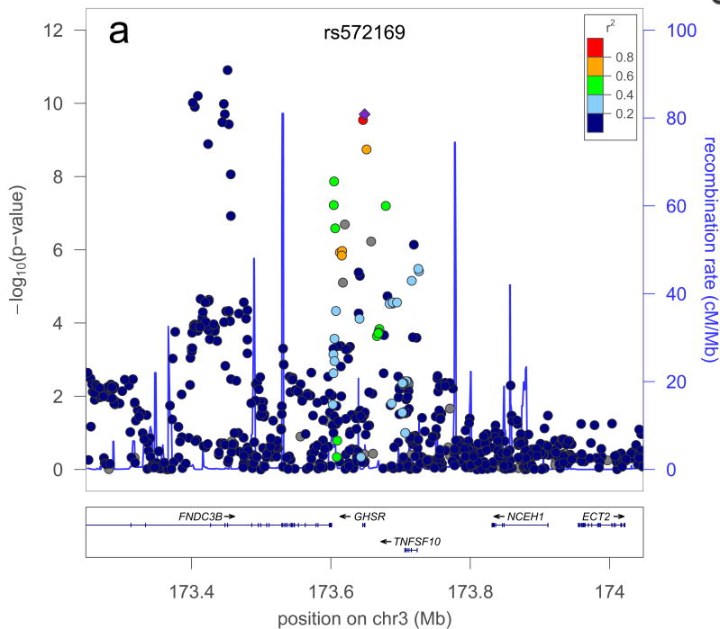
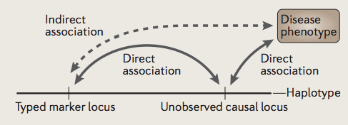
Associated locus - interpretation
What you have found
What you want to know
Variation in a locus of the genome which significantly influences your trait (disease)
A mechanism by which genetic variation influences risk for disease
Causal variant(s)
Causal gene(s)
Causal biological pathway(s)
(Lango Allen, Nature, 2010)

Slide 37
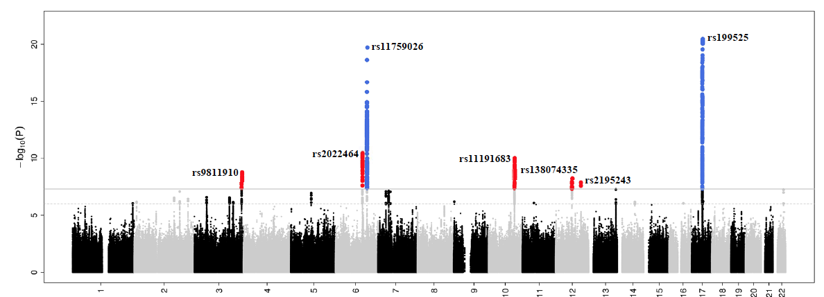
Common variant associations to brain structure
ENIGMA, CHARGE, UK Biobank all have led to large replicable results across consortia
Intracranial Volume
N ~ 33,000
(Adams, et al., Nat Neurosci, 2016)

Slide 38
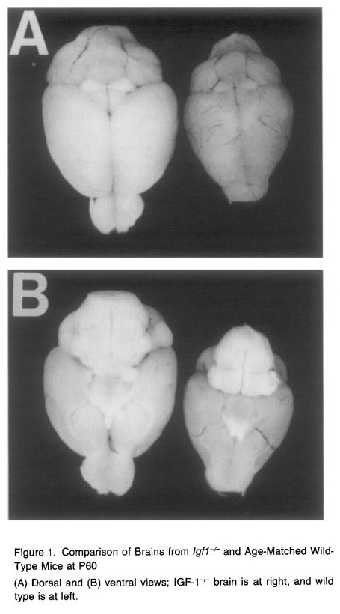
A locus of interest
(Adams, et al., Nat Neurosci, 2016; Beck et al., Neuron, 1995)
Notes:
Next, we find a hit near the transcription start site of IGF1. IGF1 is a growth factor where knockout shows a strong reduction in total body mass, including brain. IGF1 stimulates cell division in the developing brain. In addition IGF1 also increases survival of oligodendrocytes and myelin synthesis by oligodendrocytes. These GWAS hits, near genes known to be involved in neural progenitor proliferation and brain growth, give credence to the high powered analysis, identify putative regulatory regions, and can introduce to new genetic variants and genes influencing the structure of the _human_ brain.

Slide 39
Different genotyping methods for different types of variants
Linkage
Genome/exome sequencing;
CNV calling
Genome-wide association
(McCarthy, Nat Review Genet, 2008)

Slide 40
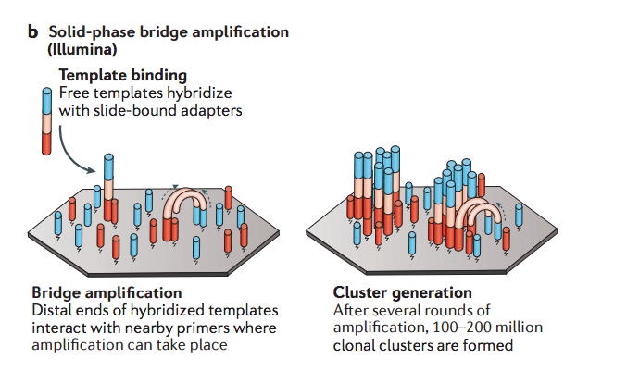
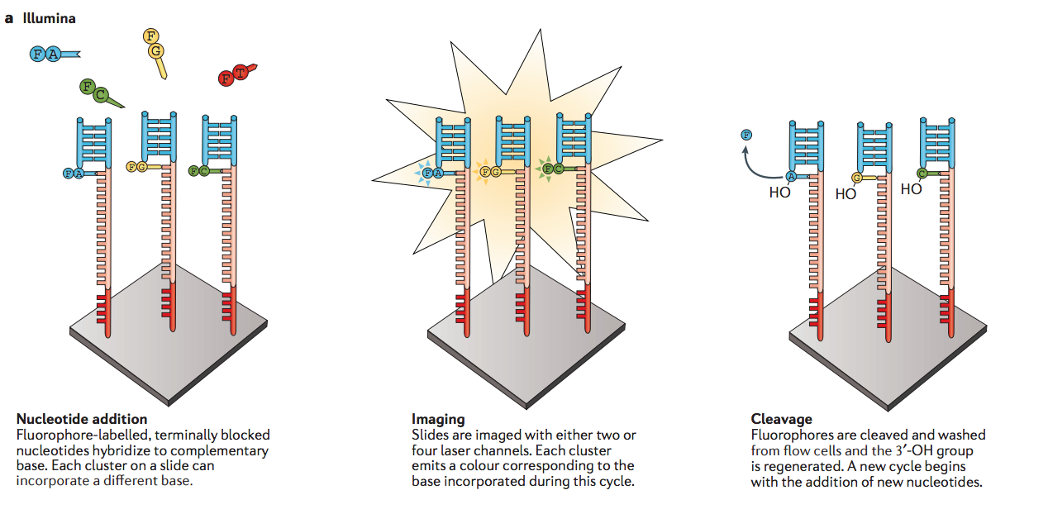
Next generation sequencing
Can simultaneously sequence chopped up versions of the genome within short reads (50-150 bp)
Take a picture after each base pair addition.
Allows genotyping of every base pair, which is good for finding rare variants
More expensive than genotyping chips
(Goodwin, Nat Review Genet, 2016)

Slide 41
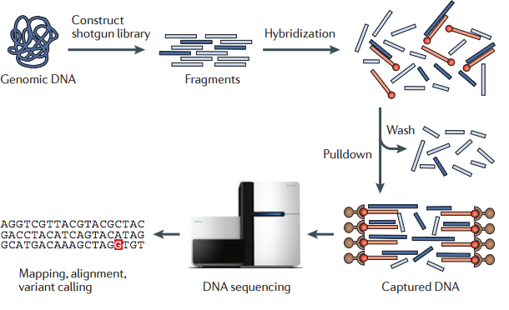
Exome sequencing
Biotinylated probes
Streptavidin pulldown
Sequencing ~3% of genome that codes for proteins is much less expensive and enriches for (currently) functionally interpretable results
(Bamshad, Nat Review Genet, 2011)

Slide 42
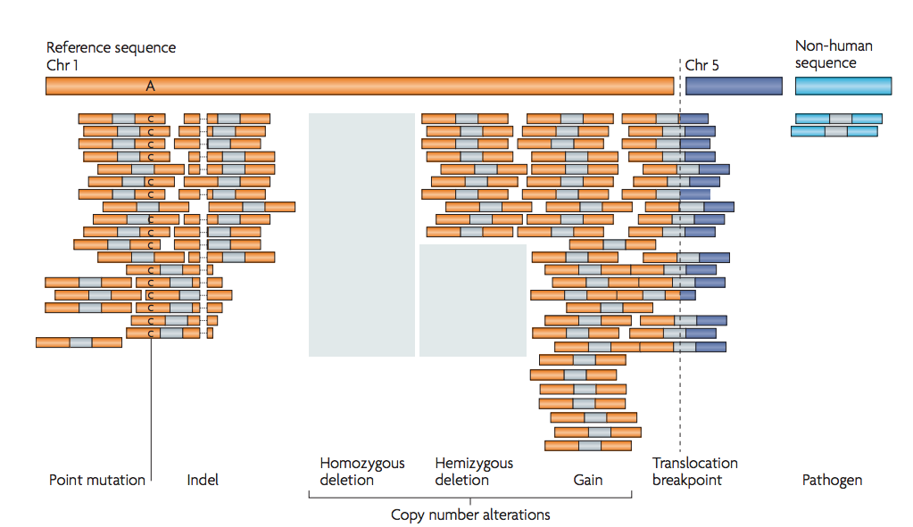
How to find genetic variation with next generation sequencing
(Meyerson, Nat Review Genet, 2010)

Slide 43
Association testing in exome or genome seq
Likely Gene Disrupting Mutation
Gene A
Gene A
Person 1
Person N+1
Person N
Person 2N
cases
control
Aggregate mutations across a feature (like a gene), count number of mutations in cases vs control, conduct a statistical test to determine if significant difference – generally called a burden test

Slide 44
Whole genome/exome sequencing in imaging genetics
Few examples so far
More to come for sure…

Slide 45
Outline
Types of genetic variation in the human genome
Some big questions in imaging genetics
Heritability
Imaging genetics history
Progress in answering the big questions

Slide 46
Some big questions in imaging genetics
How does genetic variation lead to disorders of the brain?
What cell-types and developmental processes impact brain structure?
Do genetic changes that affect brain structure also affect brain function?
What genetic changes have led to humans having big brains and unique cognitive capabilities?

Slide 47
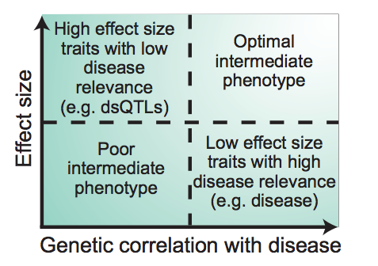
What makes an endophenotype
Notes:
Ok, so we’ve discovered genetic variants influencing brain structure, we have some new leads into interesting biology of the brain, but what does this say about disease? Well if the same genetic variants that change brain structure also create risk for disease, we have a pretty good clue that brain structure changes are involved in the disease mechanism. If genetic variants affecting brain structure have a higher effect size on brain structure than they do on the disease itself, we can study them more efficiently. This is a condensed version of what an endophenotype is.

Slide 48
What questions can we answer with endophenotypes?
Genes
Genes
Endo-phenotype
Endo-phenotype
Disease
Disease
Mediational model
Pleiotropy or Liability-Index Model
Mechanistic Study
X
Higher powered genetic search
X
X
(Kendler and Neale, Mol Psychiatry, 2010)

Slide 49
Effect sizes in brain structure GWAS
Common genetic variants have similar effect sizes on brain structure as on height and neuropsychiatric disease risk
(Franke*, Stein*, Ripke*, Nat Neurosci, 2016)
Notes:
Let’s see how well neuroimaging phenotypes meet this criteria.

Slide 50
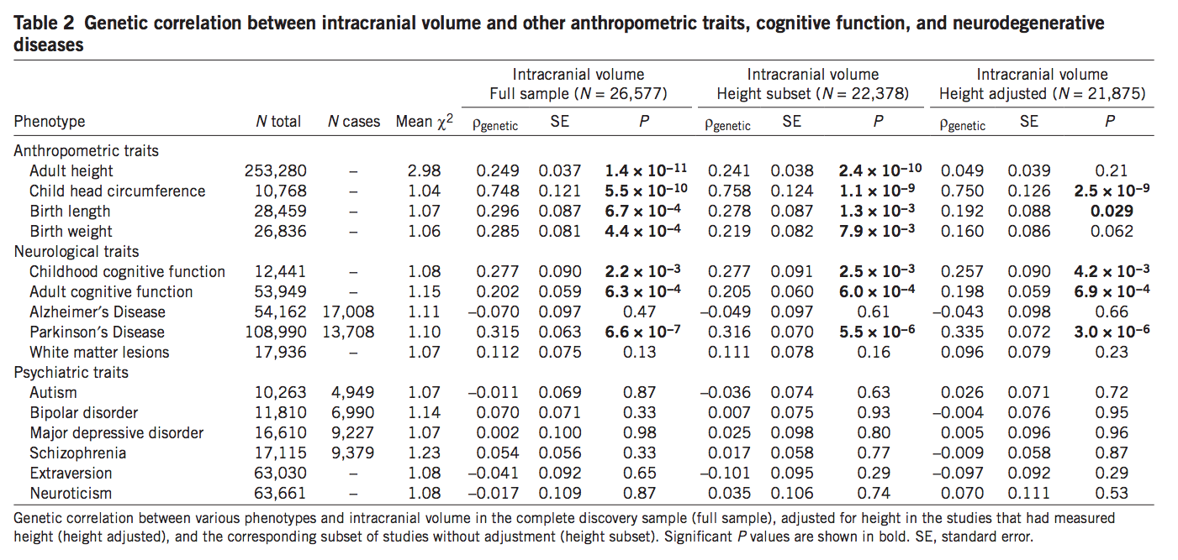
Genetic correlation with neuropsychiatric disorders/traits
(Adams*, Hibar*, Nat Neurosci, 2016)

Slide 51
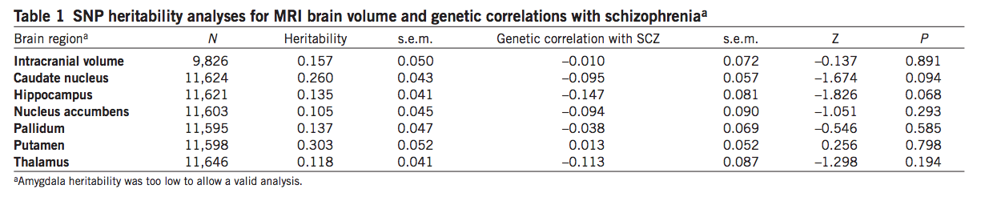
Genetic correlation with neuropsychiatric disorders/traits
Variants associated with decreased hippocampal volume are also associated with increased risk for Alzheimer's disease (r_{g}=-0.155, p=0.0034)
(Franke*, Stein*, Ripke*, Nat Neurosci, 2016; Hibar*, Adams*, Nat Commun, 2017)

Slide 52
How do structural neuroimaging phenotypes fare as endophenotypes?

Slide 53
Some big questions in imaging genetics
How does genetic variation lead to disorders of the brain?
What cell-types and developmental processes impact brain structure?
Do genetic changes that affect brain structure also affect brain function?
What genetic changes have led to humans having big brains and unique cognitive capabilities?

Slide 54
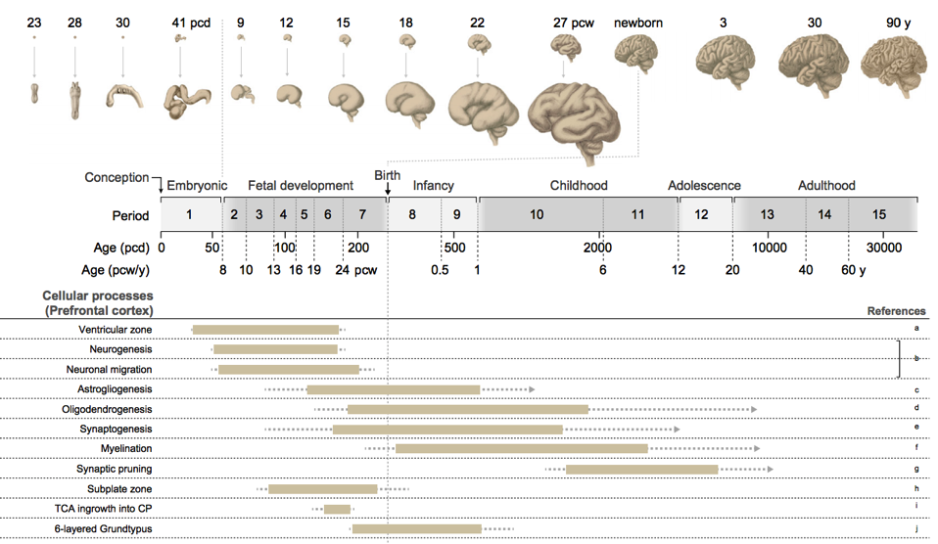
What developmental processes affect brain structure?
(Silbereis, Neuron, 2016)

Slide 55
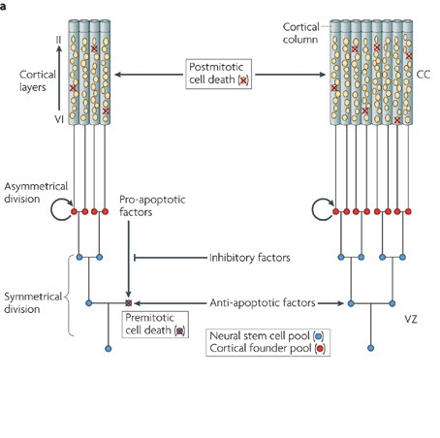
Radial unit hypothesis
The more neural progenitors that exist, the bigger the cortical surface area as more cortical columns will be created.
The more asymmetric divisions of progenitors within a column, the thicker the cortex
(Rakic, Nat Rev Neurosci, 2009; Rakic, Science, 1988)

Slide 56
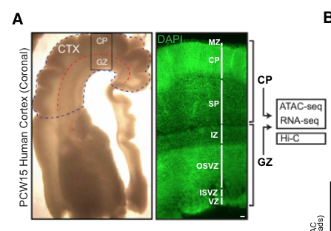
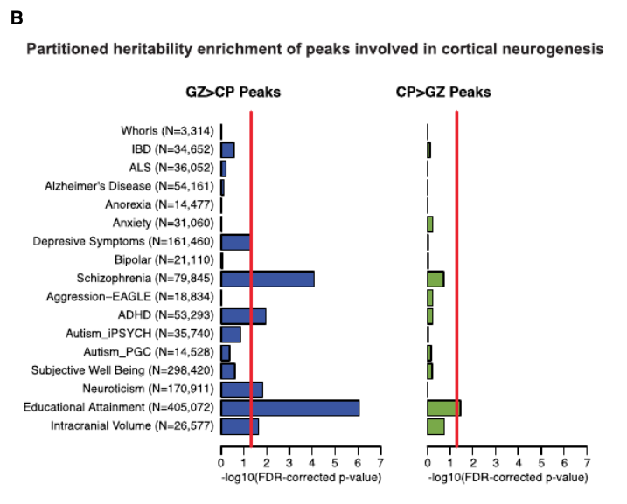
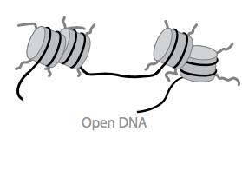
Common variants alter gene regulation of neural progenitors to influence adult brain
TFs
Transcriptional machinery
Enhancers
Promoters
(Buenrostro et al, Nature Methods, 2013; http://res.illumina.com/documents/products/research_reviews/sequencing-methods-review.pdf; de la Torre Ubieta, Stein, Cell, 2018)

Slide 57
Some big questions in imaging genetics
How does genetic variation lead to disorders of the brain?
What cell-types and developmental processes impact brain structure?
Do genetic changes that affect brain structure also affect brain function?
What genetic changes have led to humans having big brains and unique cognitive capabilities?

Slide 58
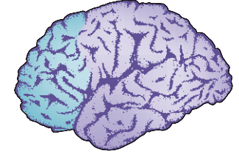


Neocortex is greatly expanded in humans as compared to (most) other animals
Human brain
Mouse brain
Greatest expansion is in surface area of neocortex (1000 fold compared to rodent) as compared to thickness (2 fold compared to rodent)
170 billion cells
(86 billion neurons)
109 million cells
(70 million neurons)
(Rakic, Nat Reviews Neurosci, 2009; Herculano-Houzel, PNAS, 2006; Geschwind and Rakic, Neuron, 2013)

Slide 59

Neocortex is greatly expanded in humans as compared to other primates
(Sousa, Cell, 2017)

Slide 60

Changes in human cranial capacity over the past 2M yrs
At 200 kya, much bigger increase in anatomicall modern human skull size
From 2 Mya to 200 kya, slow increase in brain size
(Lee and Wolpoff, Paleobiology, 2003)

Slide 61
Evidence supporting gene involvement in brain evolution
(Enard, Current Biology, 2016)

Slide 62

Utility of genetic discovery
(McCarthy, Nat Review Genet, 2008)

Slide 63
Conclusions
Each human genome harbors a great deal of genetic variation.
Some genetic variation creates changes in human brain structure.
Modern genomic methods and large sample sizes have allowed for the discovery of genetic variants influencing human brain structure.
The recent explosion of well-replicated genetic variants associated with brain structure will allow new insight into human evolution, neuropsychiatric disease risk, and brain function, if we can interpret them.

Slide 64
Questions!
What’s the difference between an allele and a SNP?
Why do we use a uniform significance threshold in genome-wide association study?
What are two important criteria for a “good” endophenotype?
If I increase the number of proliferative progenitors in the developing cortex, what happens to cortical surface area?
What are your big questions that we can answer with imaging genetics?

